Slide 1
Crime Reporting & Analysis System
AED Final Project – Fall 2015
Presenter – Ujjwal Garad
NUID – 001630224
Weekday TA – Bhavin Agarwal

Slide 2
Problem Statement
Implement an application system that will help users or rather residents to report a crime activity in real-time
The reported crimes will be directly assigned to nearest active (or on-duty) Police Officer
The Police Officer can immediately attend the reported the crime activity and analyze the situation
If required, the Police Officer can ask for the help from nearest Ambulance or Firefighter through the same application on the real time basis
The application should provide rich graphical reports in terms of line, bar, pie and trends charts.
These reports will be available to the Department Head who can analyze the crime situation depending on the frequency, pattern of the crimes in the entire region

Slide 3
Advantages of the application
Provides real-time reporting of the crimes
Transparency in the actions taken by all the individuals
There may be the situations, such as Hostage Situation, when the residents in hiding may not be able make a phone call for assistance without getting noticed by the criminals. In such cases, this application can be used to report such criminal activity.

Slide 4
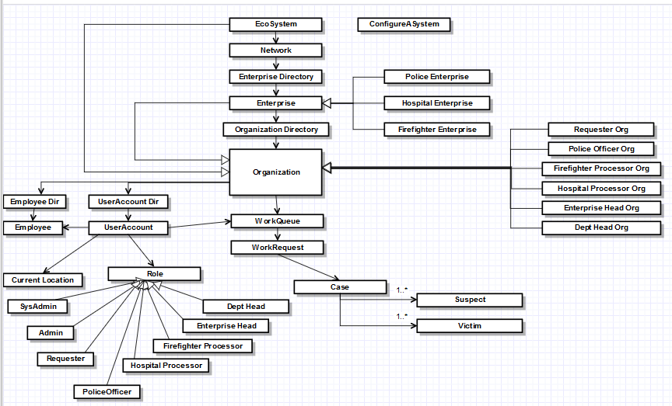
Object Model

Slide 5
Roles in the System
System Admin – handles the creation of Networks, Enterprises and their Admins
Enterprise Admin – handles creation of corresponding Organizations and the corresponding User Accounts in those Organizations
Requester – reports the crime activity as a work request through app
Police Officer – attends the work requests, performs primary analysis and takes actions, requests help from Hospital, Firefighter, Region Head, Dept Head, records Victims and Suspects to the case
Hospital Processor and Firefighter Processor - attends the work requests coming from police officer
Enterprise Head – attends the work requests which require Thorough Investigation
Dept Head – Analyzes the overall crime situation at the entire region, attends high priority work requests

Slide 6
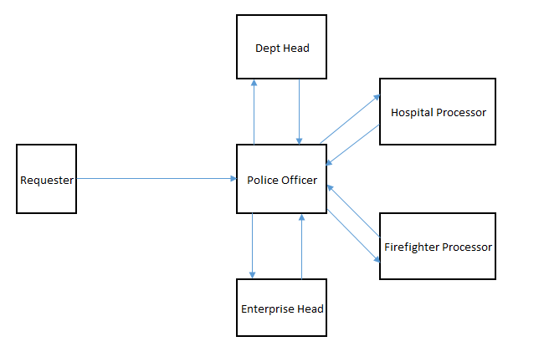
Work Request Flow

Slide 7
Key Features
The location of the every user will be tracked through the application device
The live location of the users is simulated through using Math.random() function and related operations
Used jFreeChart jar for the creation of the bar, line and pie charts
Used XYLineChart_AWT for multi-line chart
The entire data of the application can be extracted and stored in MS-Excel file using jxl jar file. This data can be used for the further data related operations in MS-Office related applications

Slide 8
Demo

